Slide 1
Correspondence and Integrations Workshop A-2 Mohanta Das and Jose Diaz 6/25/26

Slide 2





Overarching Design Principles
The goal of this project is to utilize standard Service Cloud V2 capabilities with minimal customizations. We will strive to modify our processes to Fit-to-Standard SAP technology as much as possible.
SAP First
We will adopt an “SAP first” strategy with all financial and operational data housed within SAP.
Fit to Standard
Rationalize Applications
We will change and adapt our existing business processes to fit to standard ‘out of the box’ functionality.
We will standardize and rationalize our applications to control costs and reduce the complexity of our IT estate.
Minimize customizations
‘Best of Breed’ by exception
Non-SAP applications will only be considered if they are considered ‘best of breed’ and are necessary to enable competitive advantage or meet complex regulatory requirements.
We will minimize customizations and keep the core clean to ease future upgrades, improving agility and scalability.

Slide 3
Workshop Agenda*
TOPIC
01
Recap of Last Session
List of URLs that require parameters being passed
Service Cloud Consumption Analysis Dashboard
GridX Demo- Tarah
BREAK – 10 Mins
Action Item Follow Ups from Workshop A-1
Future State Assumptions
FRICE-W
Drafted User Stories
Decisions, Action Items, Change Impacts, Wrap-Up, and Next Steps
02
03
04
05
06
07
08
09

Slide 4
01 Scope, Purpose, Objective/ Recap from Previous Session

Slide 5
Scope, Purpose, Objectives
Scope
Purpose
Objective
Scope of this document covers the to-be state for Correspondence & Integrations processes between SAP Service Cloud v2 and SAP S4HANAer
Describe the process of Correspondence & Integrations
Offer a holistic view of all the key elements of the to-be process including organization/roles, configuration or customization if needed, data, reporting, security, and controls requirements.
Define the target-state ownership and L3 processes.
Document key assumptions/decisions and outline any FRICE-W's and reports.

Slide 6
Ownership
Workshop/PDD | Level 1 | Level 2 | Level 3 | Teams Impacted | Business Process Owner | Reviewer
23.0 A-1 Correspondence & Integrations | Manage Customer Service | Correspondence & Integrations | 23.1 Correspondence | Customer | Tarah Wilson, Julie Vandblarcum | Customer Core Team
 |  |  | 23.1 View Invoices | Customer, Finance | Tarah Wilson, Julie Vandblarcum | Customer Core Team
 |  |  | 23.3 Power App Forms | Customer | Tarah Wilson, Julie Vandblarcum | Customer Core Team
WORKSHOP FACILITATION
Facilitator: Jose Diaz, Mohanta Das
IBM Scribe: Taylor Ilov
Change Impacts: Olivia Shen, Julie Vandblarcum,
CE PARTICIPANTS
Global Process Owner: Tarah Wilson, Julie Vandblarcum
SMEs

Slide 7
02 URLs that require parameters being passed

Slide 8
List of URLS that require parameters being passed
Link Name | Parameter
Online profile management | No
Customer preferences | Pass BP Number
Agent Inbox | No
CE Admin view | No
River Star | No
Dun & Bradstreet | No (Removing)
Onetime payment Agent dashboard | CA and ZIP code – CSR token
Auto pay Agent dashboard | CA and ZIP code– CSR token
Energy use details | CA and BP
Streetlight outage | Originator (CSR)
Electra | No
Transfer open items | CA
Online debit transfer | CA
Display Creditworthiness | BP – (need to validate)
Meter reading (show front office capabilities in V2- likely can remove) | Installation, BP, Device
Meter reading reversal (remove) | Installation

Slide 9
List of URLS that require parameters being passed
Link Name | Parameter
*Display Itemized statement *(covered in BMD PDD) | CA
Outage credit report | CA
Form Menu | BP
CSR Fraud forms | No
*EMMA Case (cover in Case Management PDD)
Resend FACTA Link PIR
Brochures (not needed)
Pre Pay Portal (not needed)
Auto Pay Agent Dashboard (Paymentus) (Covered in Agent Desktop)
Pay station list (not needed)
ASP Site (Not needed) -everything ASP related can be gone
Gold Check + Gold Check History– not needed
EAM Business Role – to create and change TBD (needed?) (Security team has not finished role consolidation exercise yet) - Dawn Checking

Slide 10
03 Service Cloud Consumption Analysis Dashboard

Slide 11
BREAK! - 10 mins

Slide 12
05 Action Items from Workshop A-1

Slide 13
Action items from Workshop A-1
Review Critical Fields for Factsheet – Tarah had meeting with CSRs on this, emailed over documentation
Old Archived Docs (from Open Text) Usage – Tarah posted details in ADO
List of types of documentation used for the ISIS integration – Tarah sent email

Slide 14
06 Assumptions for Future State

Slide 15
Assumptions for Future State
Mashups will launch the existing S4HANA/Third party screen without modification.​
If River Star CRM development needed in SCV2, then corresponding POC needs to be done in CAP(Node.js) before converting the items to WRICEF.

Slide 16
07 WRICEF

Slide 17
WRICEF Identified
1. Opentext Integration
2. PowerApp Integration/Fraud Tips
3. Form Management System Integration mashup
4. ISIS integration (invoice)
5. Riverstar integration ?
6. Agent Inbox?

Slide 18
08 Drafted User Stories

Slide 19
User Stories for Correspondence & Integrations
Please note, this is just a drafted starting point we will leverage to formulate our actual user stories and acceptance criteria
L1 | L2 | L3 | L4 | User Story | Acceptance Criteria
Manage Customer Service | Correspondence Forms | View Invoices | Dispaly Invoices | As an SAP Customer Service Representative, I want to view invoices within the correspondence forms area so that I can promptly access necessary invoice information during service-related inquiries. | 1. Able to display an invoice when selected. 3.Able to display all available invoices for viewing. 4.Able to display invoice information in read-only mode. 5.Able to display invoices without leaving the correspondence forms area. 6.Able to display invoice information consistently on repeated access. 7.Able to display invoice content clearly on screen. 8.Able to display invoices sequentially when navigating between them. 9.Able to build Security roles and perform testing. 10.Able to identify Risk and Controls
Manage Customer Service | Correspondence Forms | View Invoices | Create / Modify Invoices | As an SAP Customer Service Representative, I want to view invoices within correspondence forms to support accurate customer interactions and timely service resolution. | 1. Able to modify an existing invoice. 3.Able to initiate invoice creation from correspondence forms. 4.Able to initiate invoice modification from correspondence forms. 5.Able to confirm invoice creation within the correspondence context. 6.Able to confirm invoice modification within the correspondence context. 7.Able to view created invoices within correspondence forms. 8.Able to view modified invoices within correspondence forms. 9.Able to build Security roles and perform testing. 10.Able to identify Risk and Controls

Slide 20
09 Key Decisions, Action Items, Change Impacts, Wrap-Up & Next Steps

Slide 21
Program Charging (CE Internal Only)
The Change & Why:
We need to track O&M costs more precisely. OCM and Data Conversion must be charged separately from End User Training and from Design/Build/Deployment work. This change is retroactive from February for Accounting, Rate case discovery, and audit.
Ask:
Pls follow the instructions below that apply to you based on your staffing category on the LaunchPad program. It is critical to track costs in the correct cost buckets.
Business Partner (BP) Core Team (Use SAP*):
Continue 100% allocation as before. (BP&A handles this automatically behind the scenes and no time entry is needed except for the two scenarios below)
Submit time only for OCM and Data Conversion activities; Use SAP to bill IO 6520973.
Submit time only for End User Training; Use SAP to bill IO 6519532.
IT Core Team (Use Clarity):
S4- Customer – Design/Development/Testing/Deploy Clarity Task
Clarity Timesheets will now be used for time charging, and the allocation mechanism is discontinued. Submit timesheets from February 2nd for a one-time catchup.
Separate tasks for OCM, End User Training, and Data Conversion are available; Find them using keywords OCM, End User Training, and Data Conversion and charge them as applicable.
Extended BP Team (use SAP*):
Bill SAP IO 6520973 for OCM and Data Conversion.
Bill SAP IO 6519532 for End User Training.
Use new IO 6521411 for all other tasks.
Extended IT Team (Use Clarity):
S4- Customer – Design/Development/Testing/Deploy Clarity Task
Bill specific tasks for OCM, End User Training, and Data Conversion; ID the tasks using the keywords OCM, End User Training, and Data Conversion.
Bill other tasks as appropriate.
*SAP Timesheet Submission Instructions (for BPs)
Follow ESS steps (screen shot below): 1. Open ESS timesheet. 2. Enter IO number in work order field. 3. Select WORK code under ATT-ABS. 4. Add OCM, End User Training, or Data Conversion in comments. 5. Enter hours worked.

Slide 22
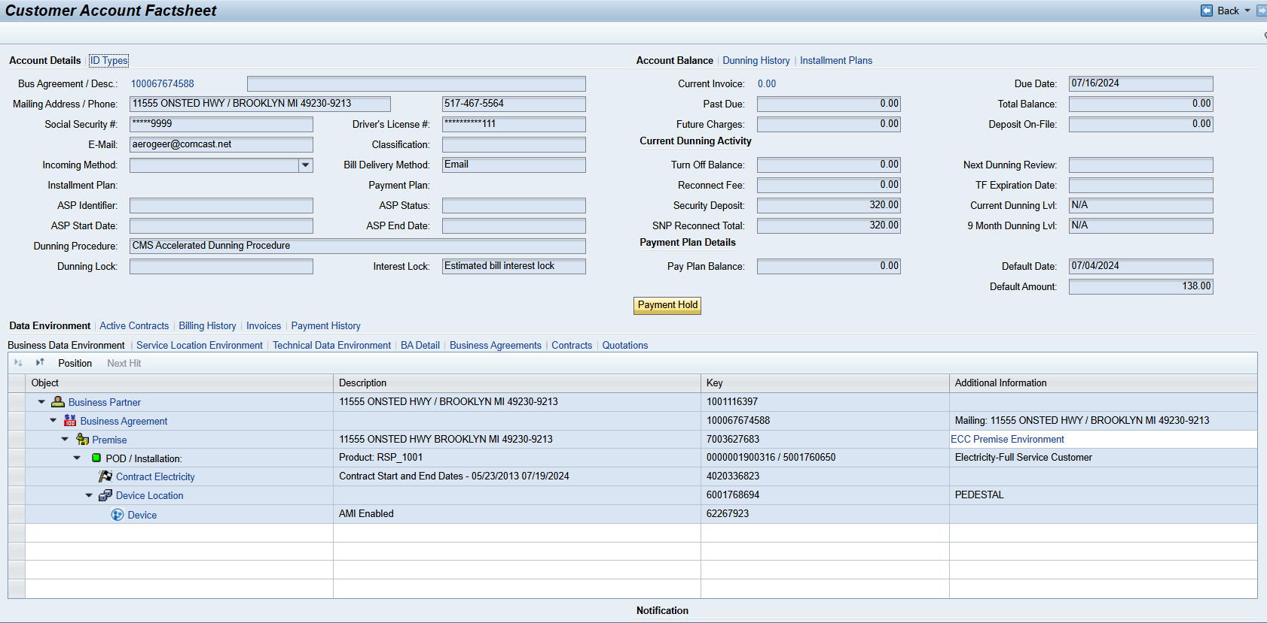
Open Text integration- Customer Fact Sheet

Slide 23
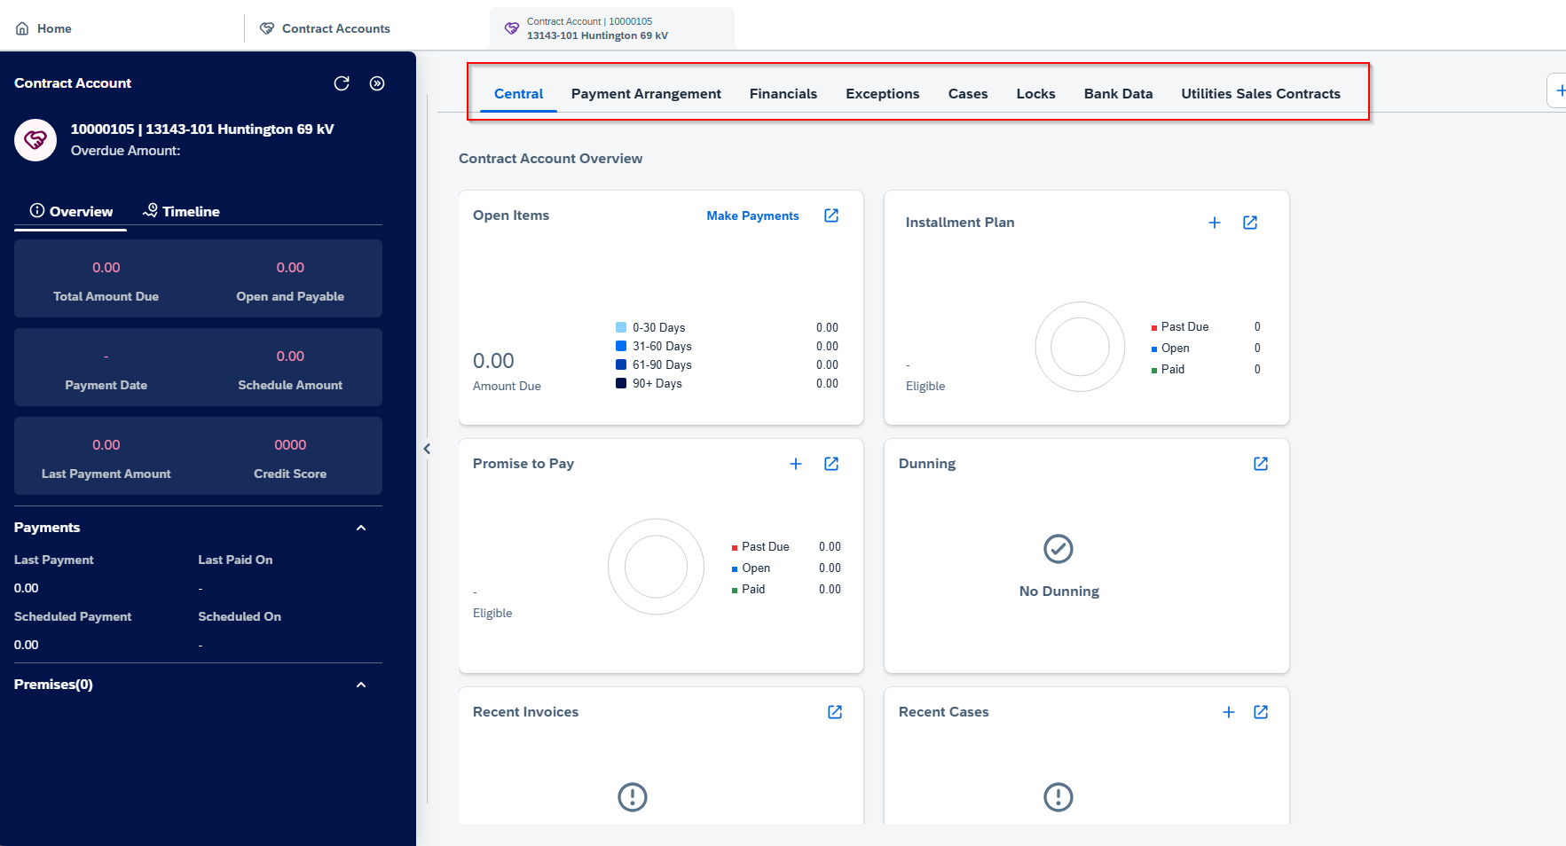
Contract Account- Utilities financial details suffices the requirement. Account Fact sheet is not part of SAP Standard. Additional mashup require for Data environment.

Slide 24
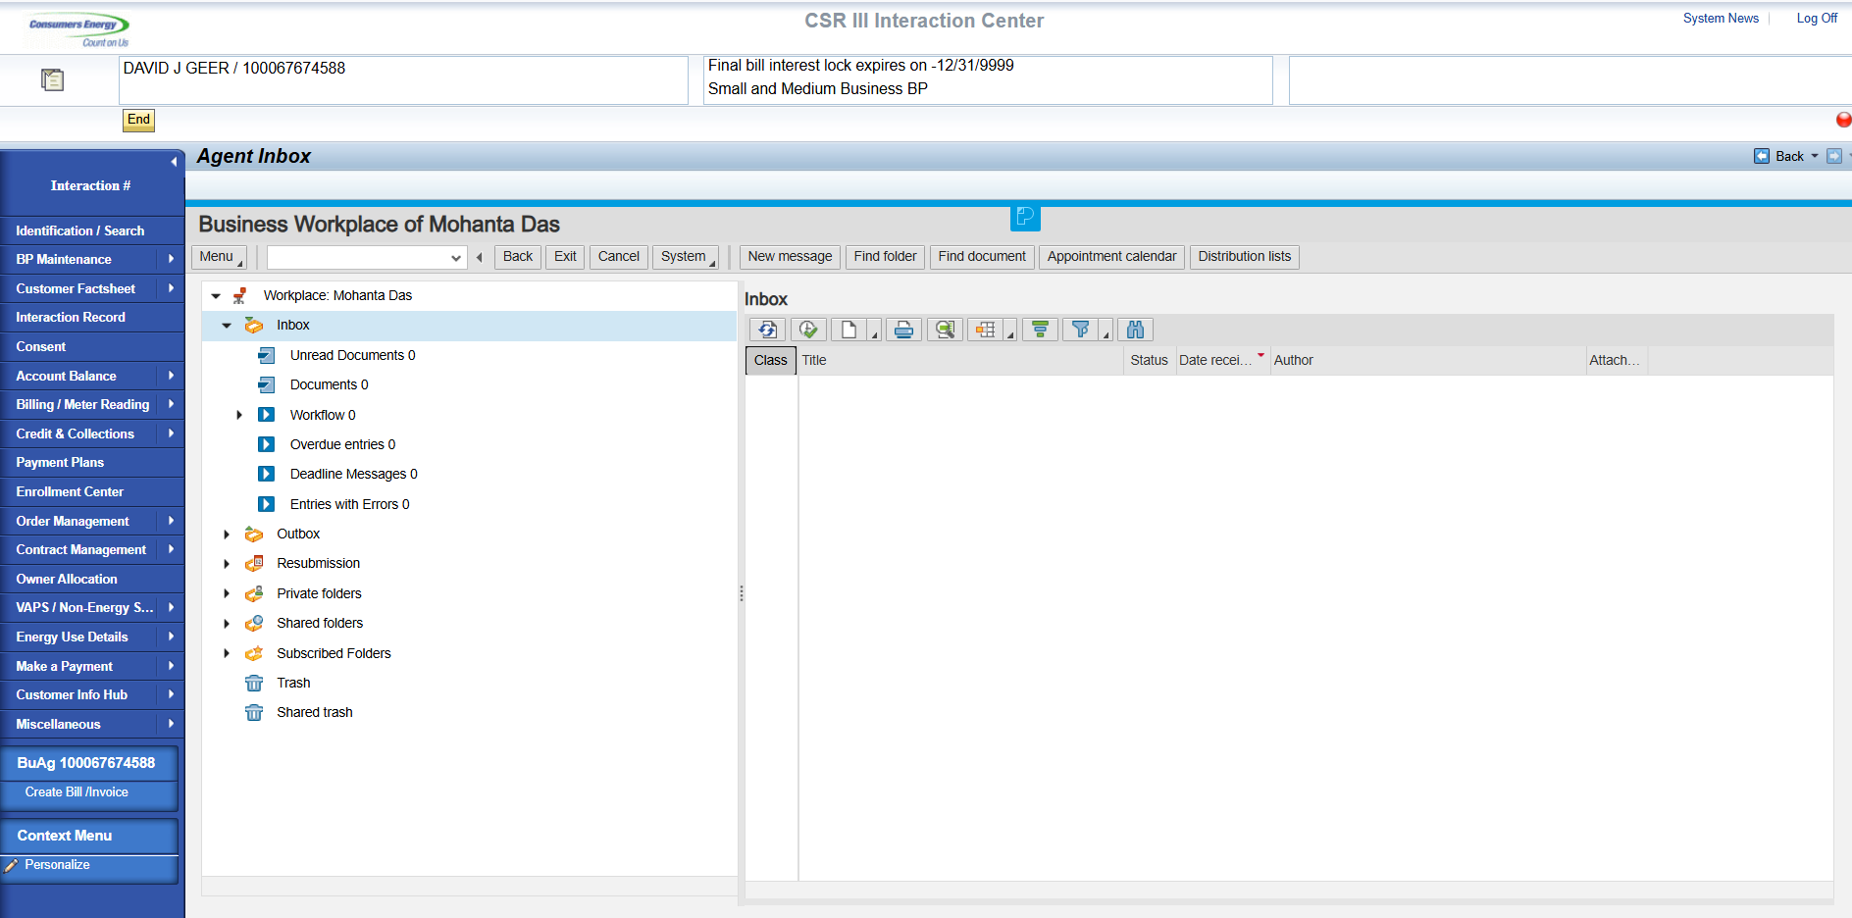
Agent Inbox- Mashup needs to be configured in Service Cloud V2

Slide 25
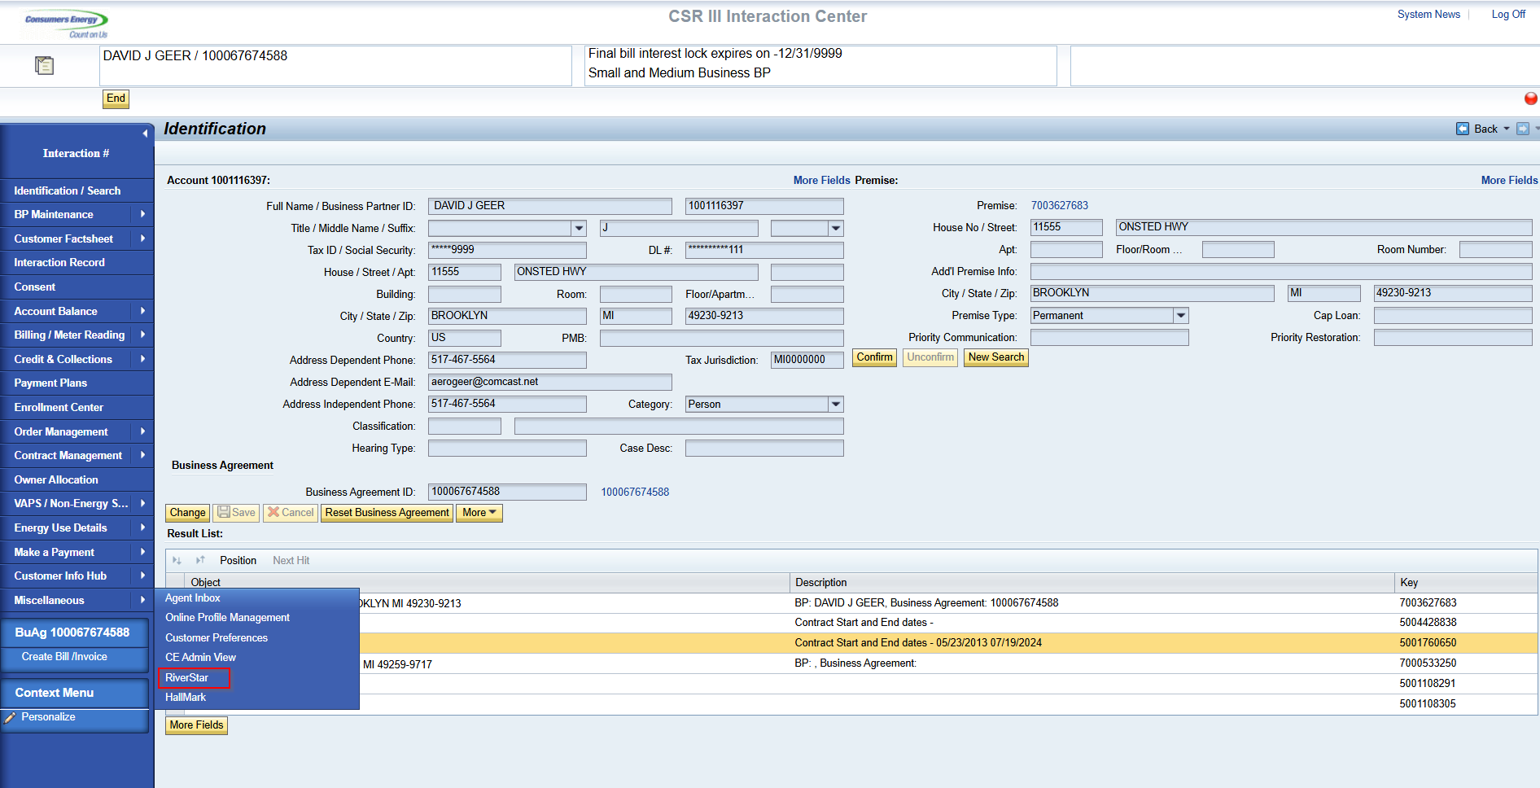
River Star- Mashup needs to be configured in Service Cloud V2

Slide 26
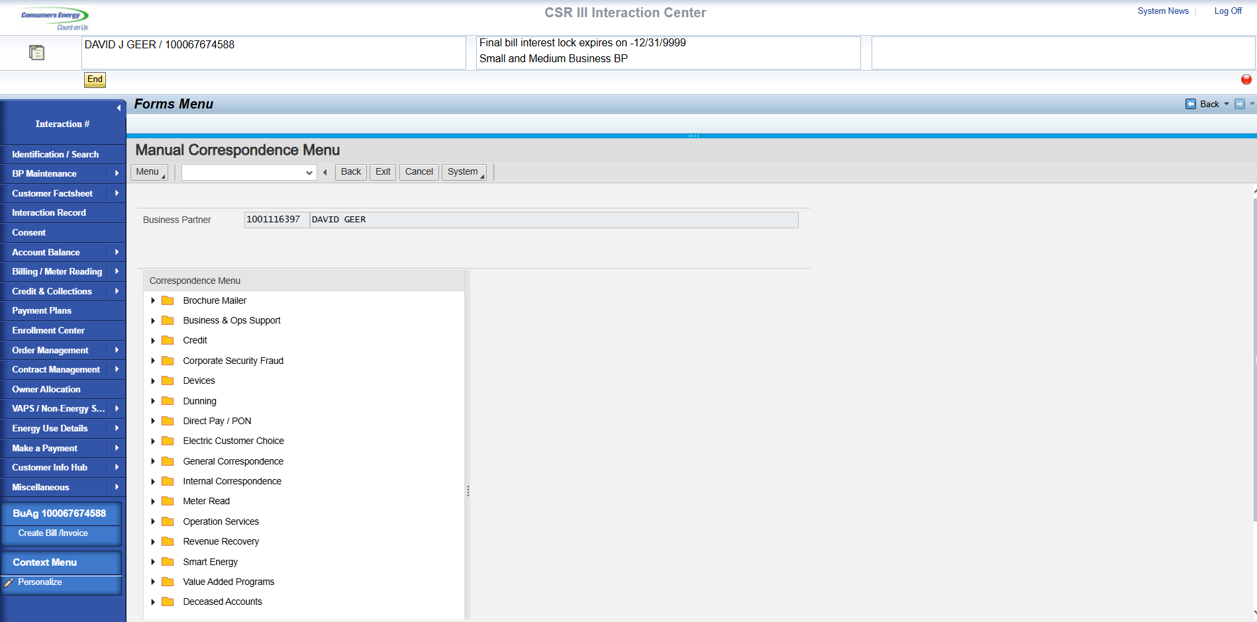
Form Management- Mashup needs to be configured in Service Cloud V2

Slide 27
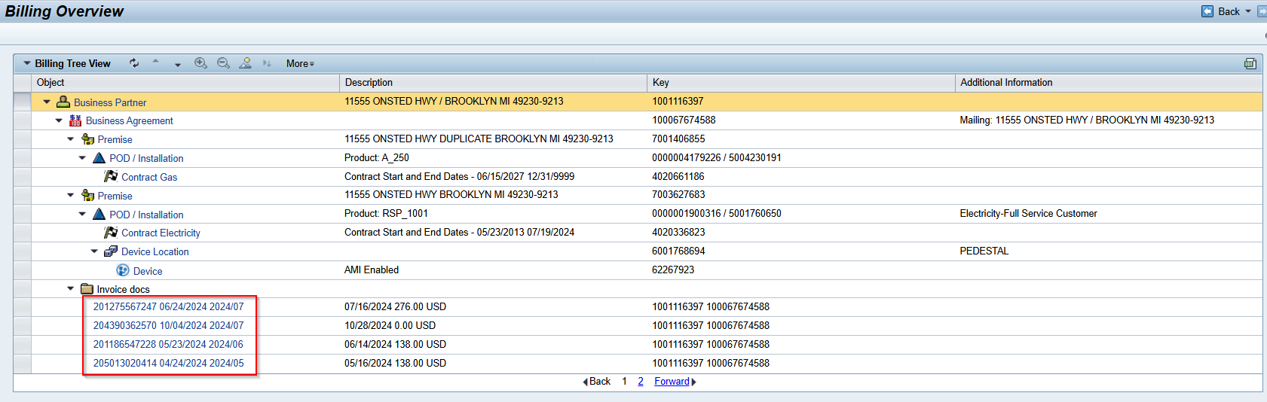
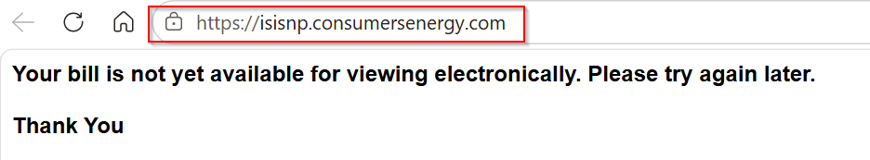
ISIS integration for Invoice- Technical configuration needed to create External Link in SCV2 to dynamically map Invoice id.

Slide 28
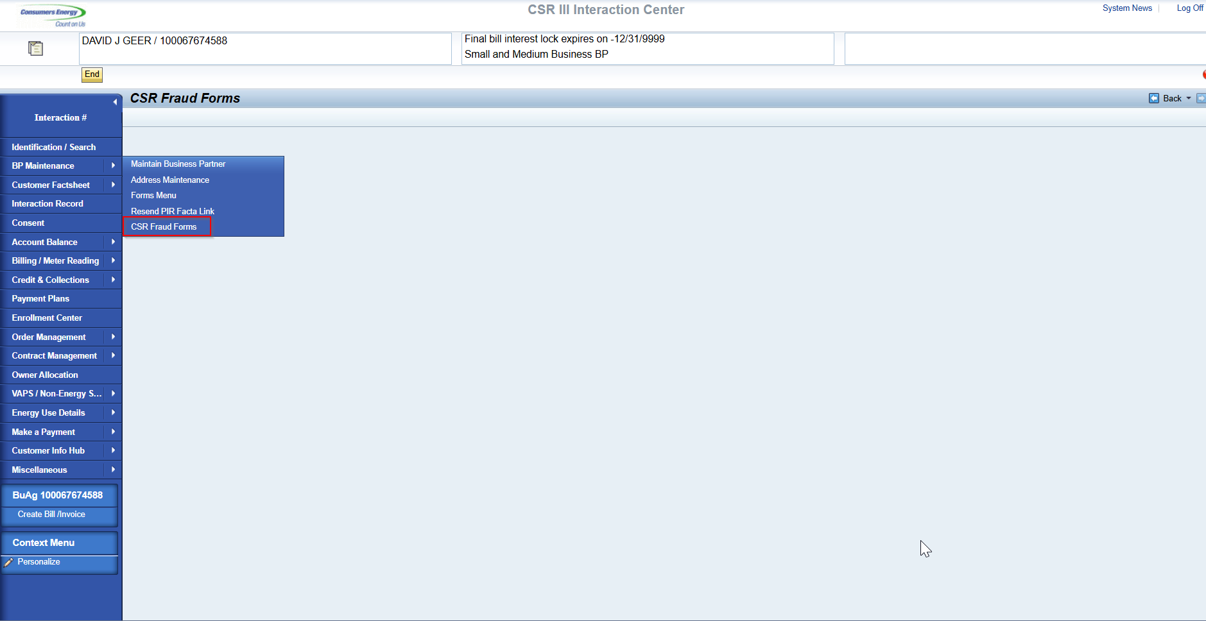
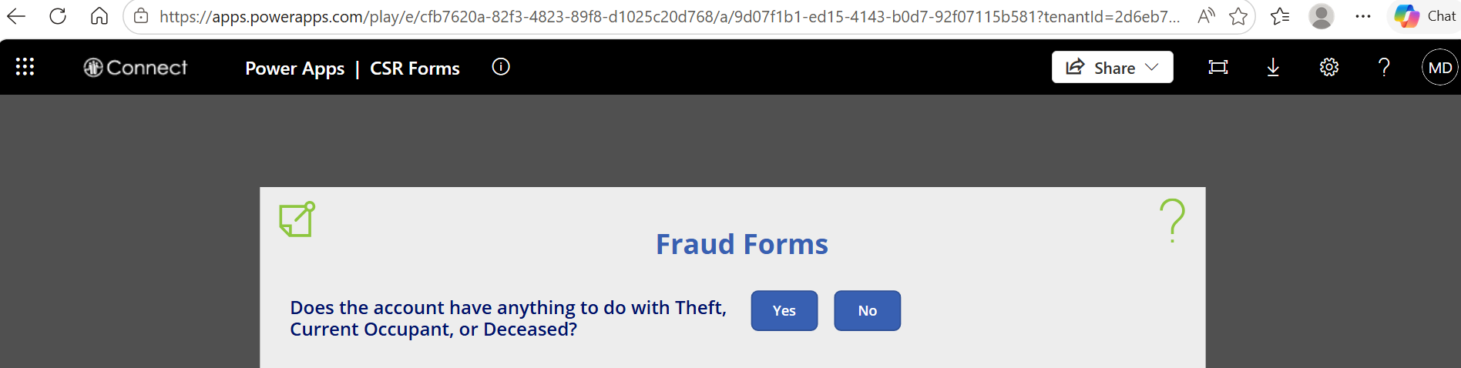
Power App Integration - CSR Fraud Forms Mashup needs to be configured in Service Cloud V2

